Slide 1


Justified True Beliefs
The next step towards the study of formal ignorance.
Mirko Tagliaferri

Slide 2
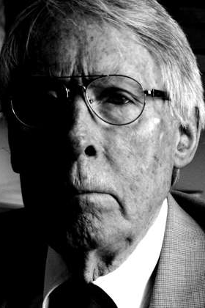
Classic Approach to Formal Ignorance
Ignorance is defined in terms of (the lack of) knowledge.
Knowledge is then formally defined, in multi-modal languages, as true beliefs.

Slide 3

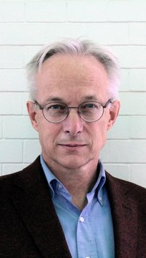
Solutions?

Slide 4
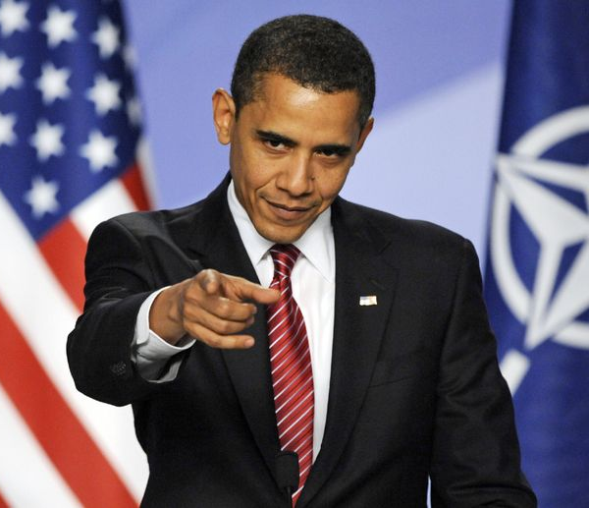
Can we try to do better?

Slide 5
Yes, we can!
Kind of...

Slide 6
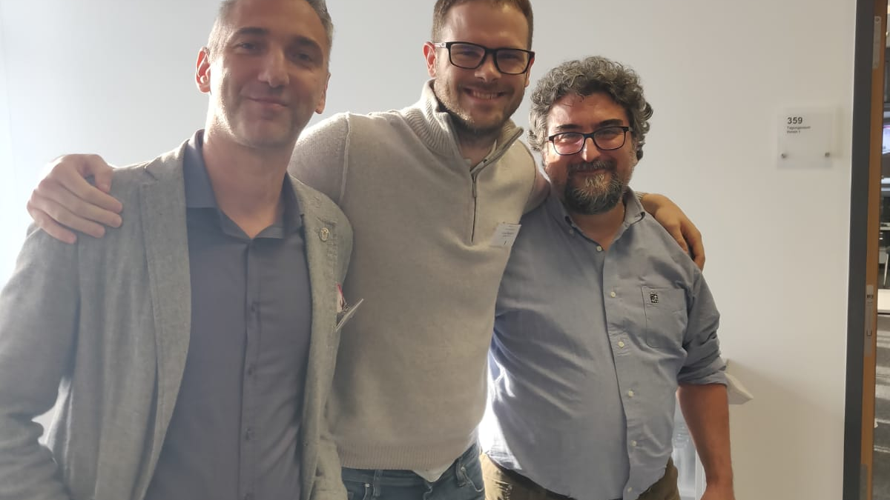
Starting point
Reasoning About Ignorance and Beliefs

Slide 7

Syntax & Semantics
$$φ≔p\left|¬φ\right|φ∧φ\left|B\left(φ\right)\right|E_{l}\left(φ\right)|E_{c}\left(φ\right)$$
$$𝔐=\left(W, π, R_{B}, ε\right)$$

Slide 8
Examples
Credulity.
Belief Perseverance.
Disbelief.

Slide 9
...and next (formal)?
Work on potential relationships between evidence and beliefs.
Provide axiomatizations and meta-theorems for both the basic language the relationships just mentioned.
Implement and explore the impact of dynamics on ignorance of an agent.

Slide 10
...and next (cognitive science)?
Study potential educational methodologies based on the formal results obtained.
Evaluate novel communication strategies in an ideal setting to get insights into potential applications.

Slide 11
Thanks for your attention
mirko.tagliaferri@uniurb.it

